Slide 1
EQUINE EARLY DEVELOPMENT AND IMPLANTATION
From blastocyst formation to establishment of the endometrial cup
Allen C. Enders
University of California Davis

Slide 2
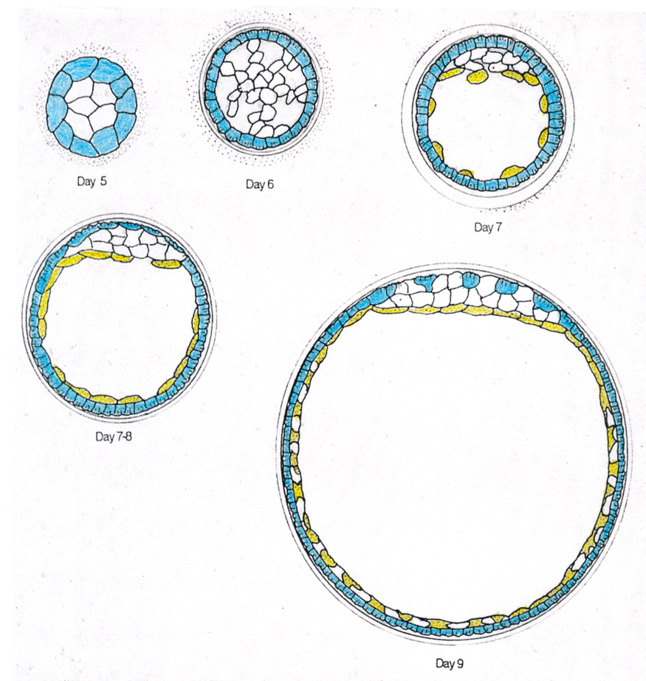
Day 7 – 18 The blastocyst moves around within the uterine horns and body until day 16, when it becomes fixed in position. During this period the blastocyst is encompassed by a capsule.
The development of the blastocyst is unusual in that the early endodermal cells are initially scattered around the cavity before forming a continuous layer.

Slide 3
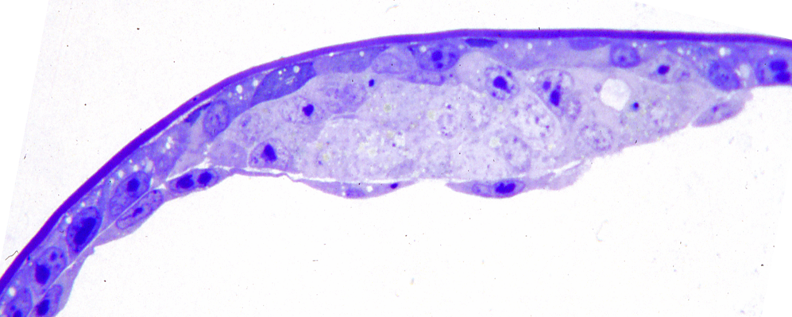
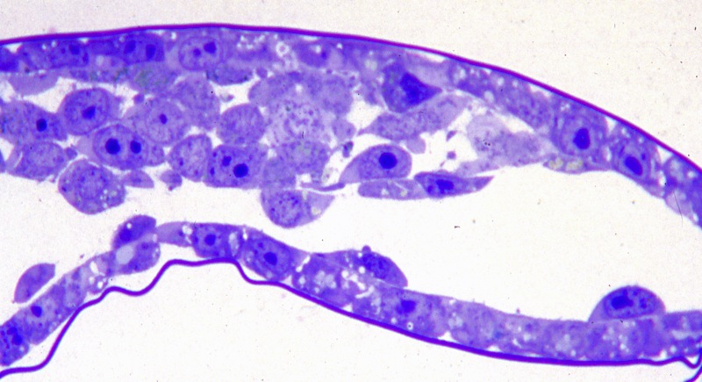
The capsule covers the dark trophoblast cells. The pale inner cell mass (ICM) cells that will form the epiblast are above a loosely associated cluster of three endoderm cells.
Collapsed blastocyst, showing ICM and abembryonic trophoblast.

Slide 4
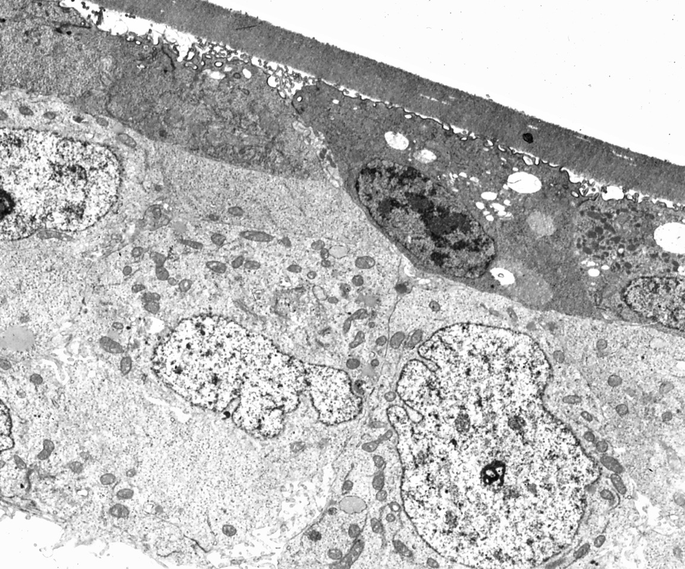
At this stage trophoblast forms a continuous layer over the ICM and under the capsule.

Slide 5
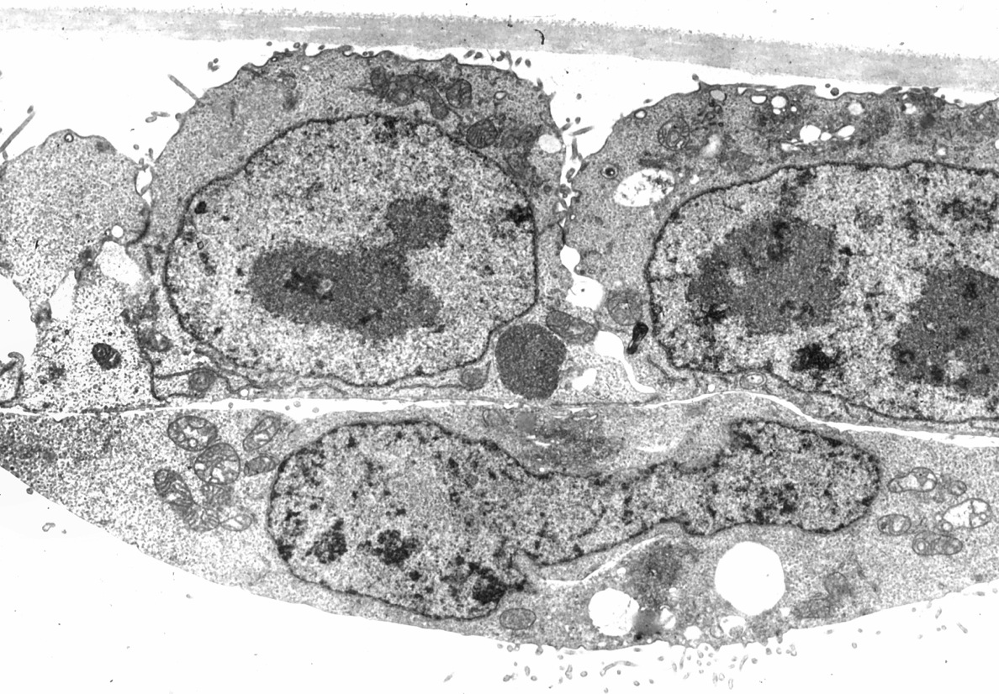
An endoderm cell under parietal trophoblast.

Slide 6
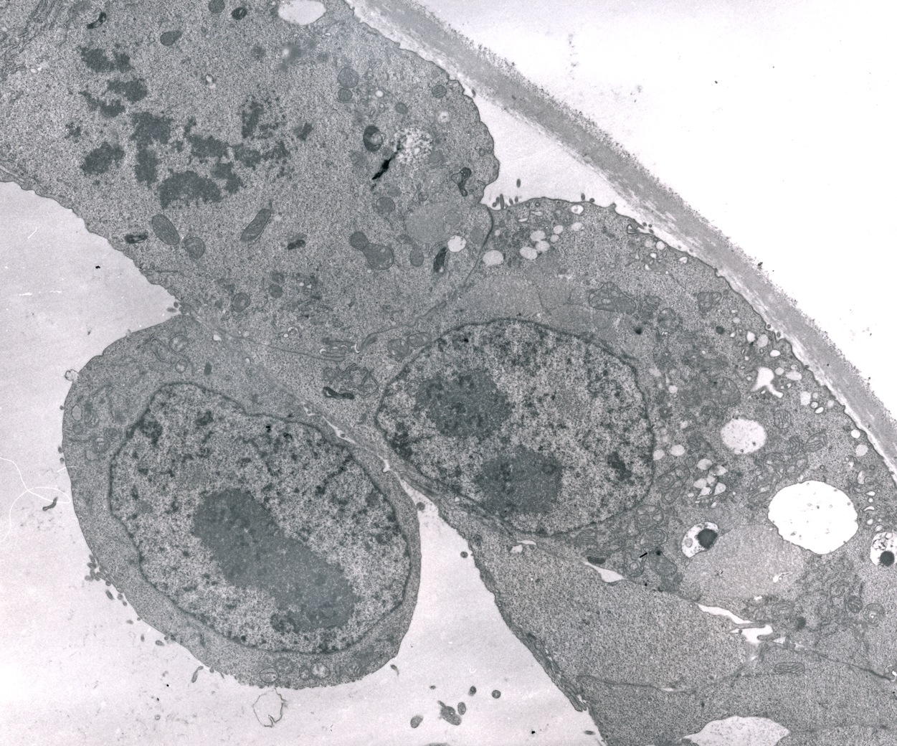
Note the mitotic figure in the trophoblast cell above the endodermal cell.

Slide 7
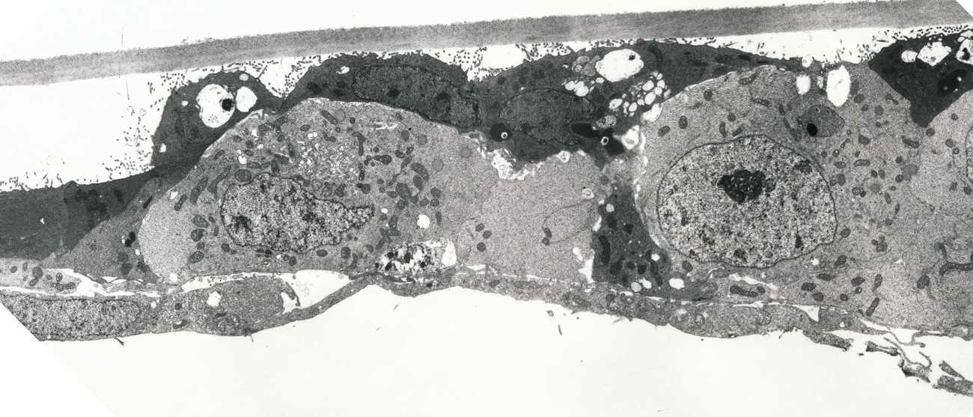
Day 9. The connections between trophoblast cells are thinning.
Note the discontinuity of trophoblast over the ICM in the upper right of the electron micrograph.

Slide 8
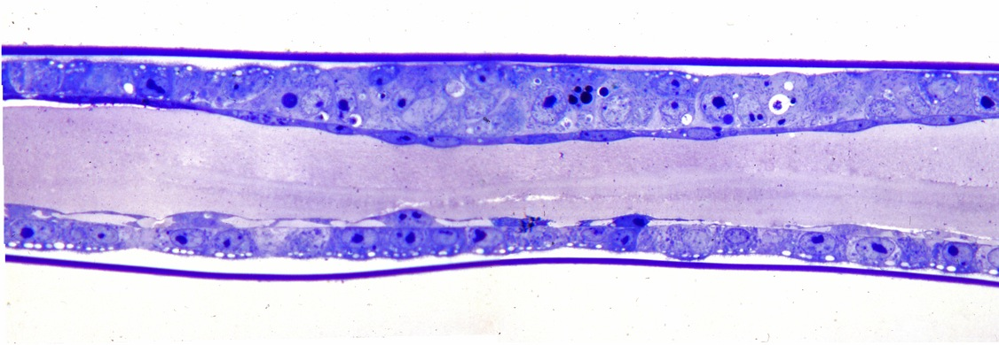
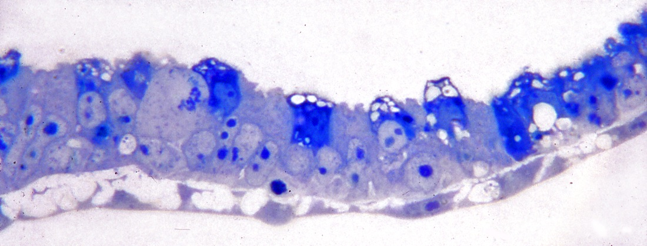
Collapsed blastocyst showing ICM and abembryonic trophoblast.
Note spaces within the endodermal layer abembryonically.
Day 10. The trophoblast cells associated with the ICM are isolated and vacuolated.

Slide 9
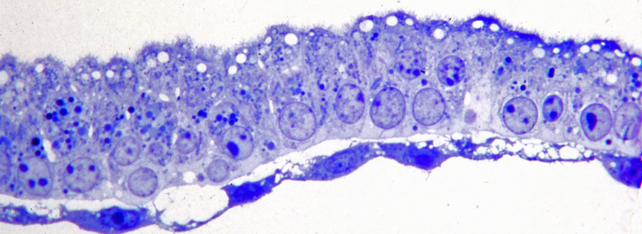
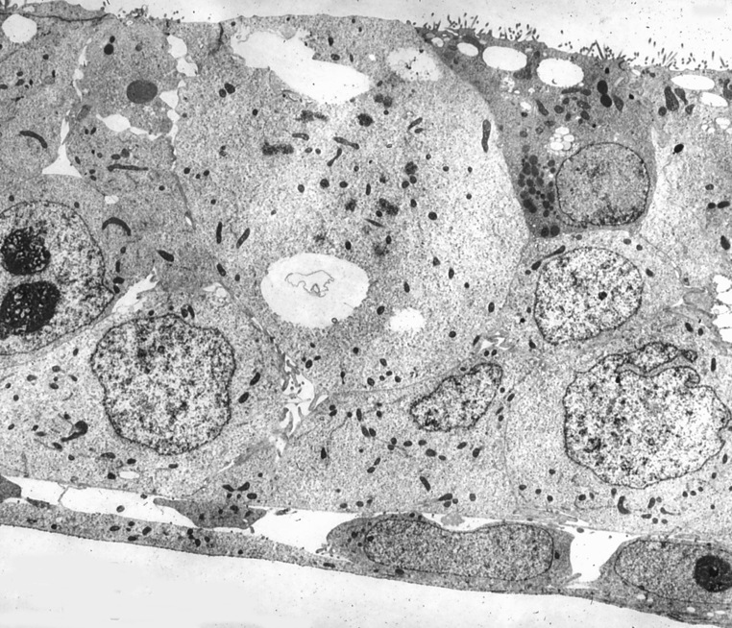
An ICM denuded of trophoblast.
Day 11. TEM showing an isolated trophoblast cell in the upper right.

Slide 10
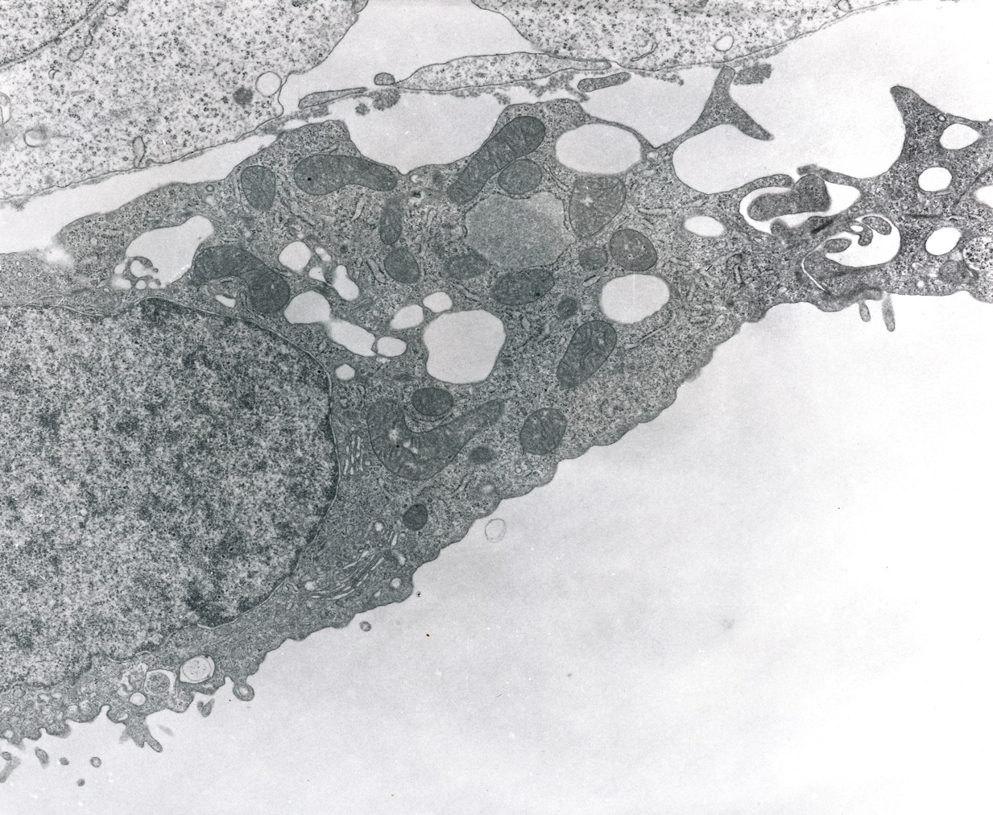
Endoderm cell showing spaces within the endodermal layer.

Slide 11
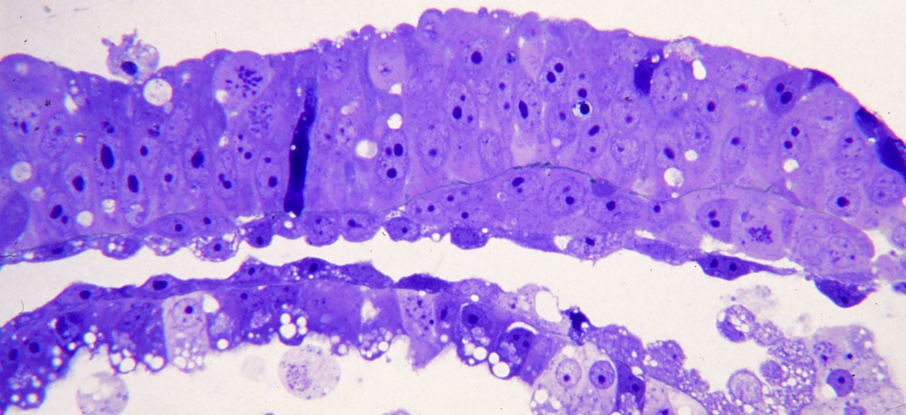
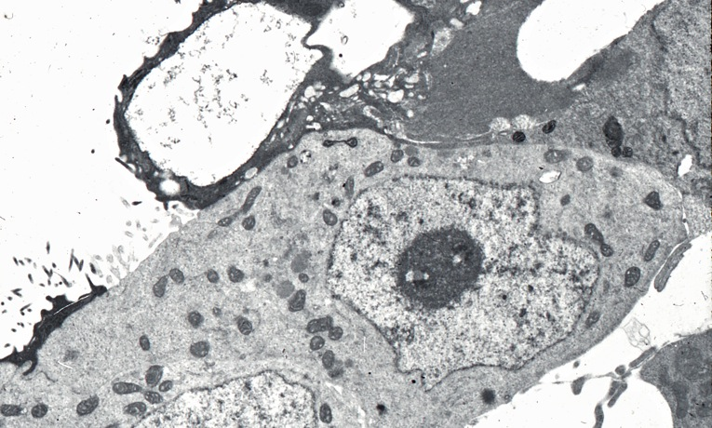
Day 12. To the right under the epiblast a cluster of mesodermal cells is seen between epiblast and endoderm. Parietal trophoblast and endoderm is below.
Dark trophoblast cells appear to be in a position that would indicate sloughing from the ICM.

Slide 12
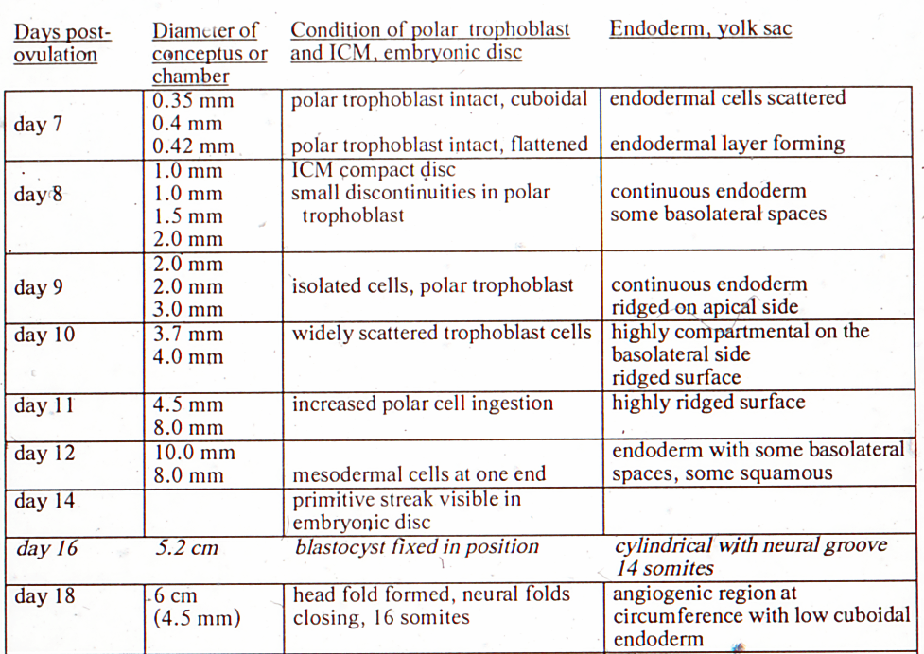

Slide 13
FIXED BUT UNIMPLANTED BLASTOCYST STAGE
After day 16 the blastocyst is fixed in position within the uterus.
Since it is still surrounded by the capsule, it cannot be considered implanted.

Slide 14
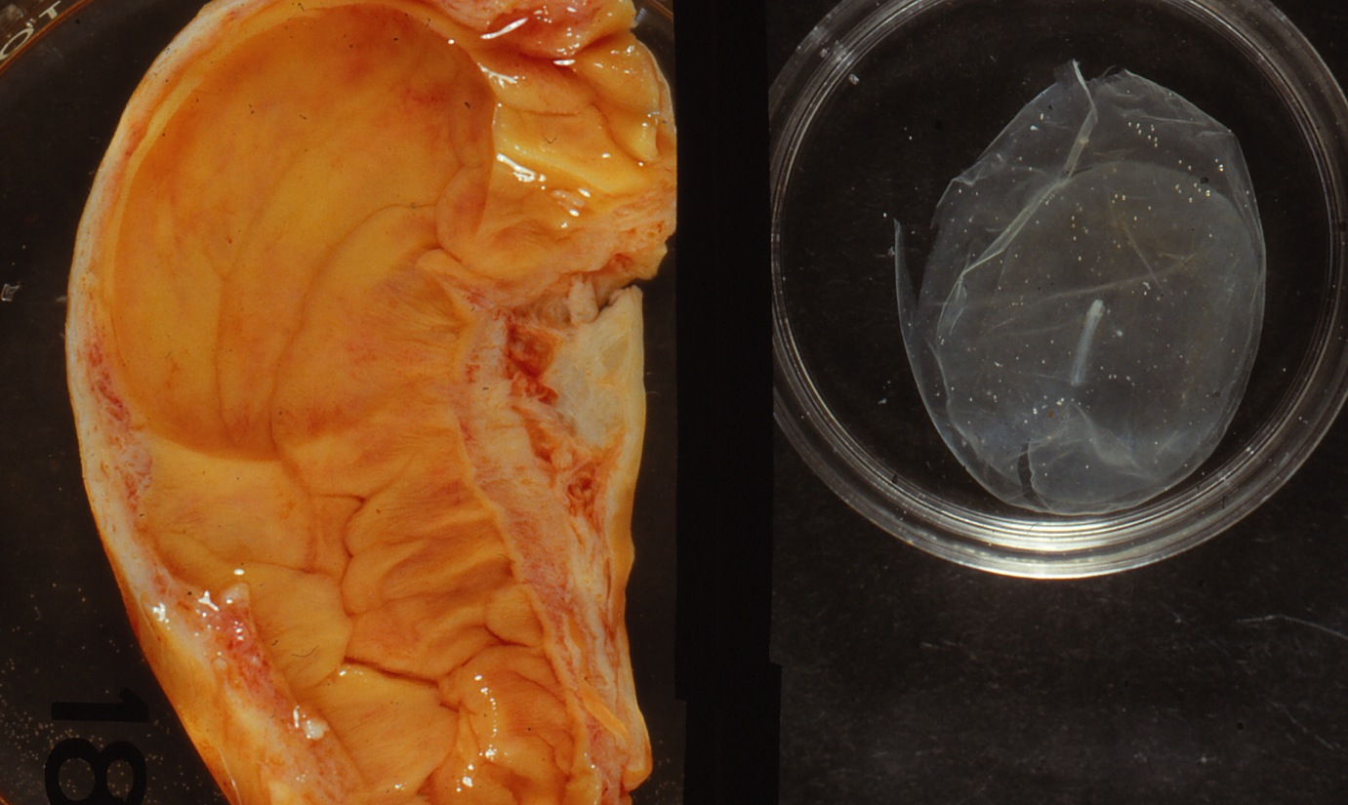
Day 18. On the left is the depression in the endometrium where the blastocyst on the right was fixed in position.
Note the embryo in the blastocyst on the right, and the surrounding capsule which has been ruptured.

Slide 15
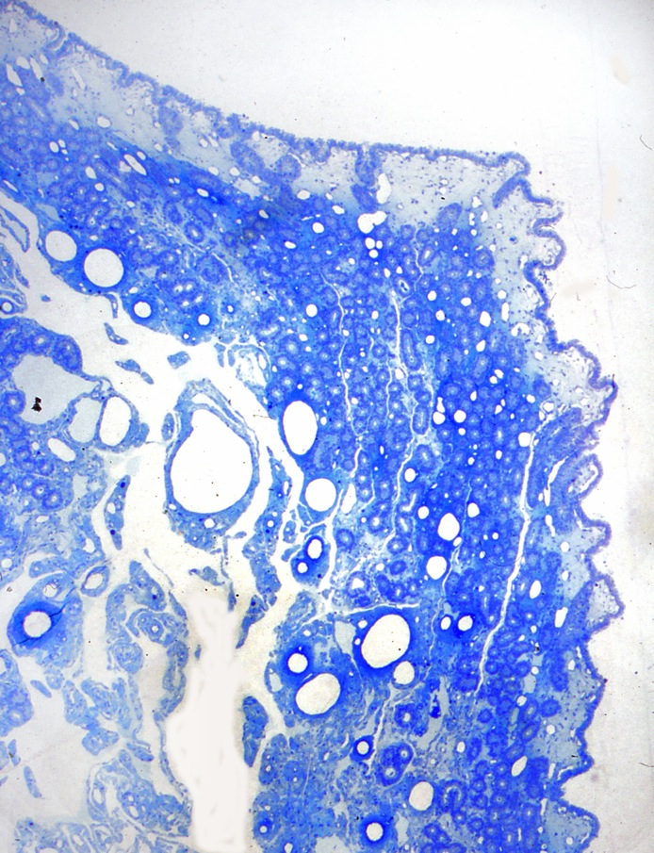
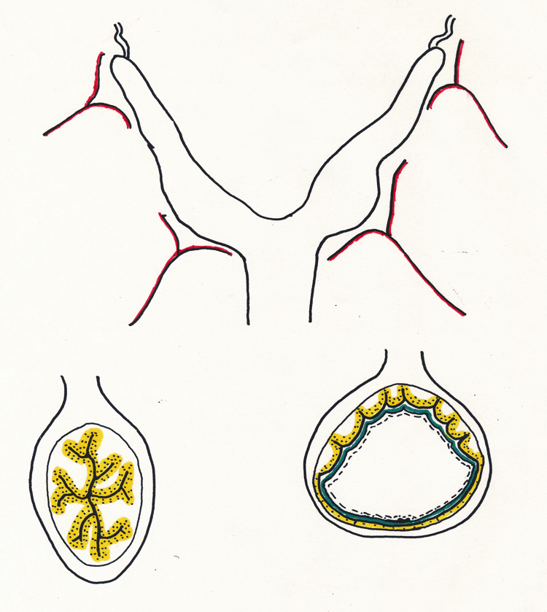
On day 18 the blastocyst is situated in one or the other uterine horns near the body of the uterus, where it has been since fixation. Left is a cross section of a uterine horn without a blastocyst; right is a cross section thru the blastocyst. The embryo is situated opposite the mesometrium.
In the upper left is the smooth surface of endometrium that abutted the blastocyst. On the right is the irregular surface that was abutting adjacent endometrium.

Slide 16
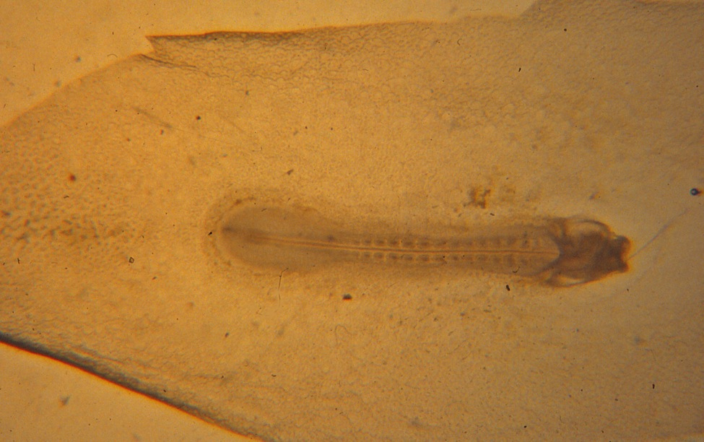
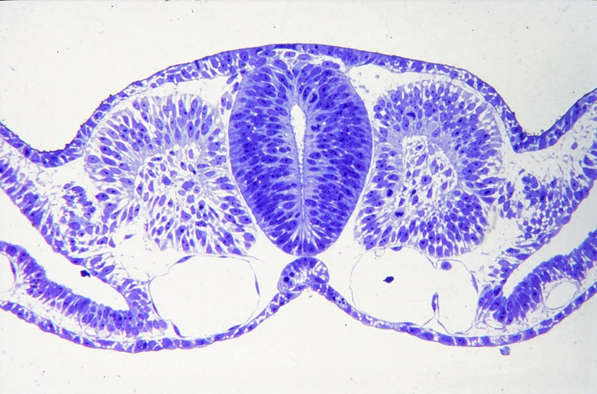
Note the somites and head fold of a day 18 blastocyst. The area lateral to the blastocyst is a region of yolk sac beginning to form erythrocytes.
Cross section of a somite region

Slide 17
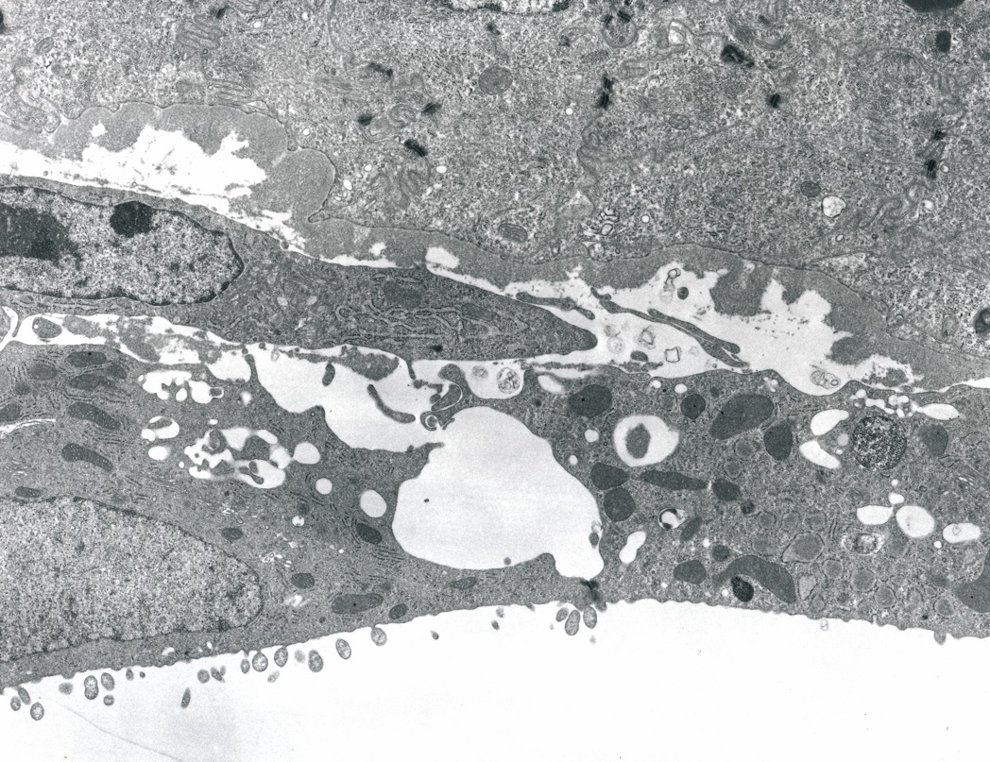
The mesoderm has extended between the endoderm and trophoblast except on the extreme right.
A mesoderm cell on the left intrudes between the basal lamina of the trophoblast and the endoderm cells.

Slide 18
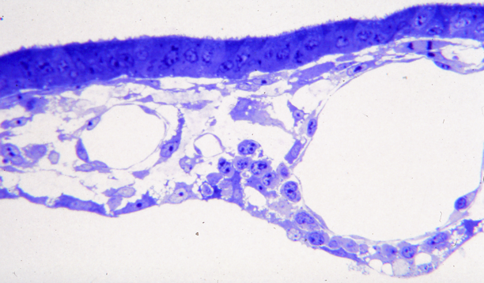
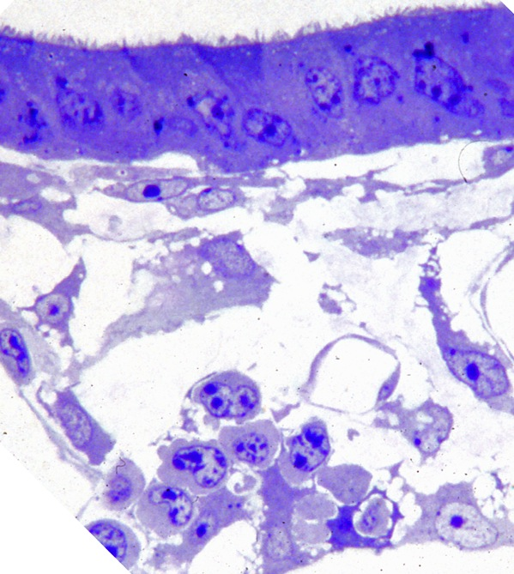
A small and large developing vessel are under the trophoblast. Note hemopoietic cells in the wedge between these vessels.
On the bottom is a cluster of hemopoietic cells.

Slide 19
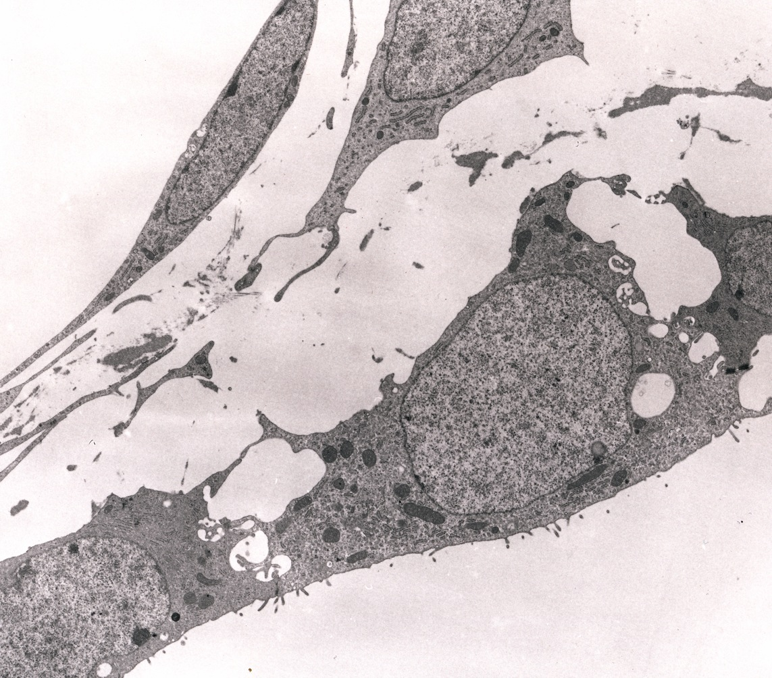
The endoderm layer (below) underlies connective tissue around the endothelial cell of a blood vessel in the upper left.

Slide 20
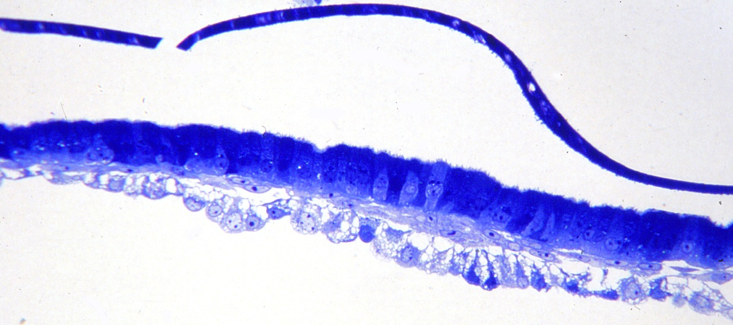
The broken capsule overlies a region with mesoderm but not vessels.
Bilaminar yolk sac. Note the cuboidal trophoblast cells.

Slide 21
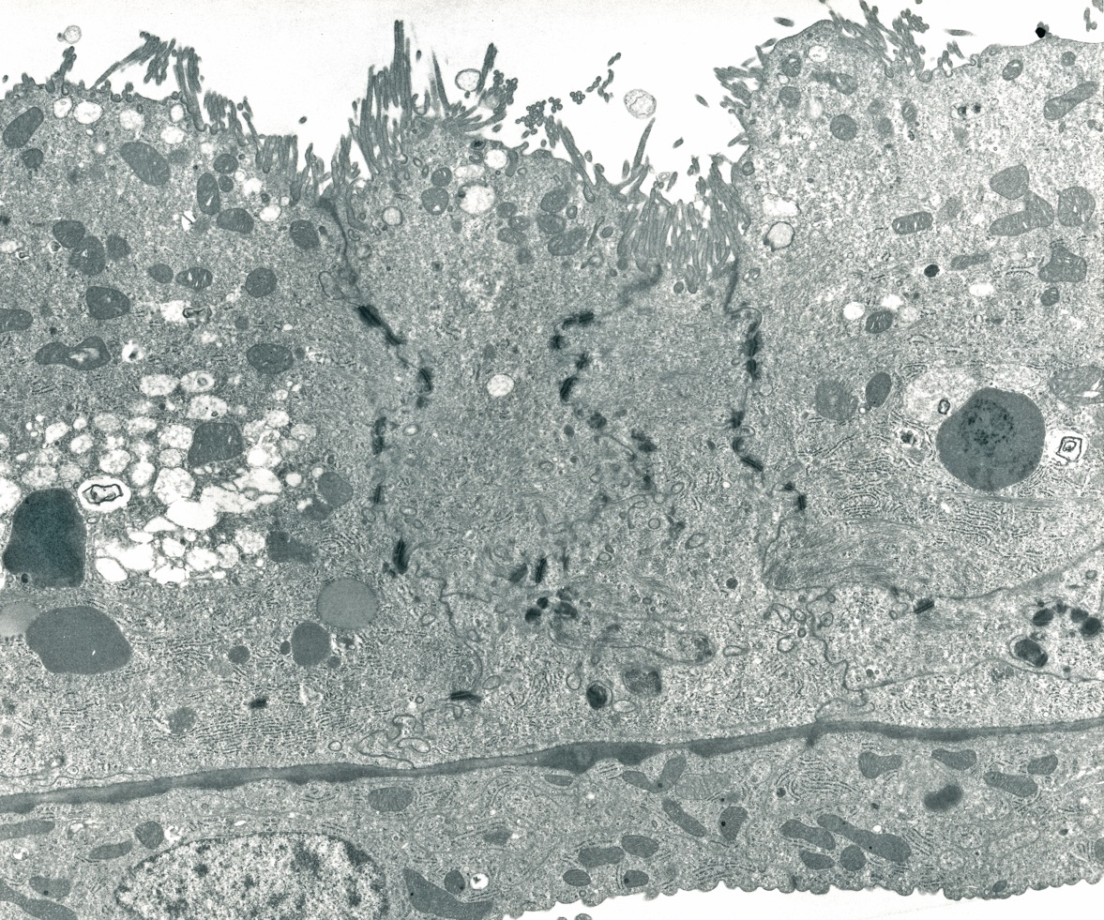
Irregular microvilli extend from the surface of trophoblast cells.
The endoderm cells show bumps that in three dimension are ridges.

Slide 22
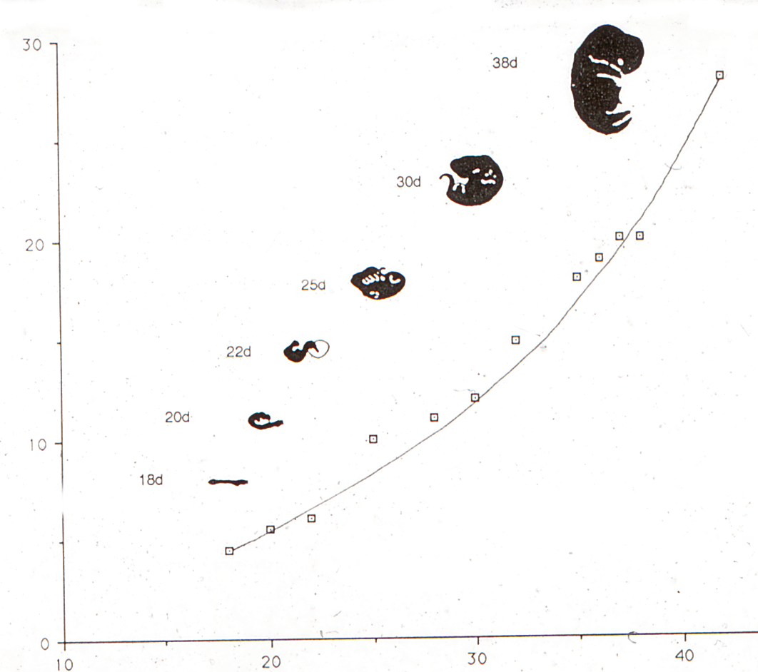
CR in mm
Days gestation

Slide 23
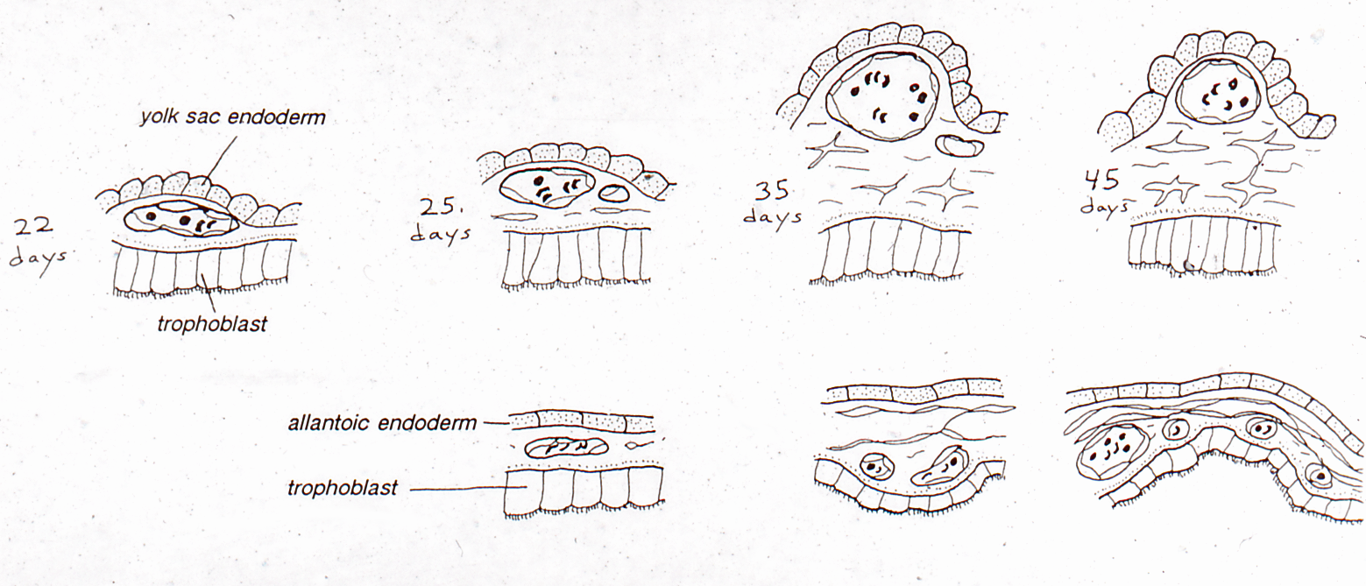

Slide 24
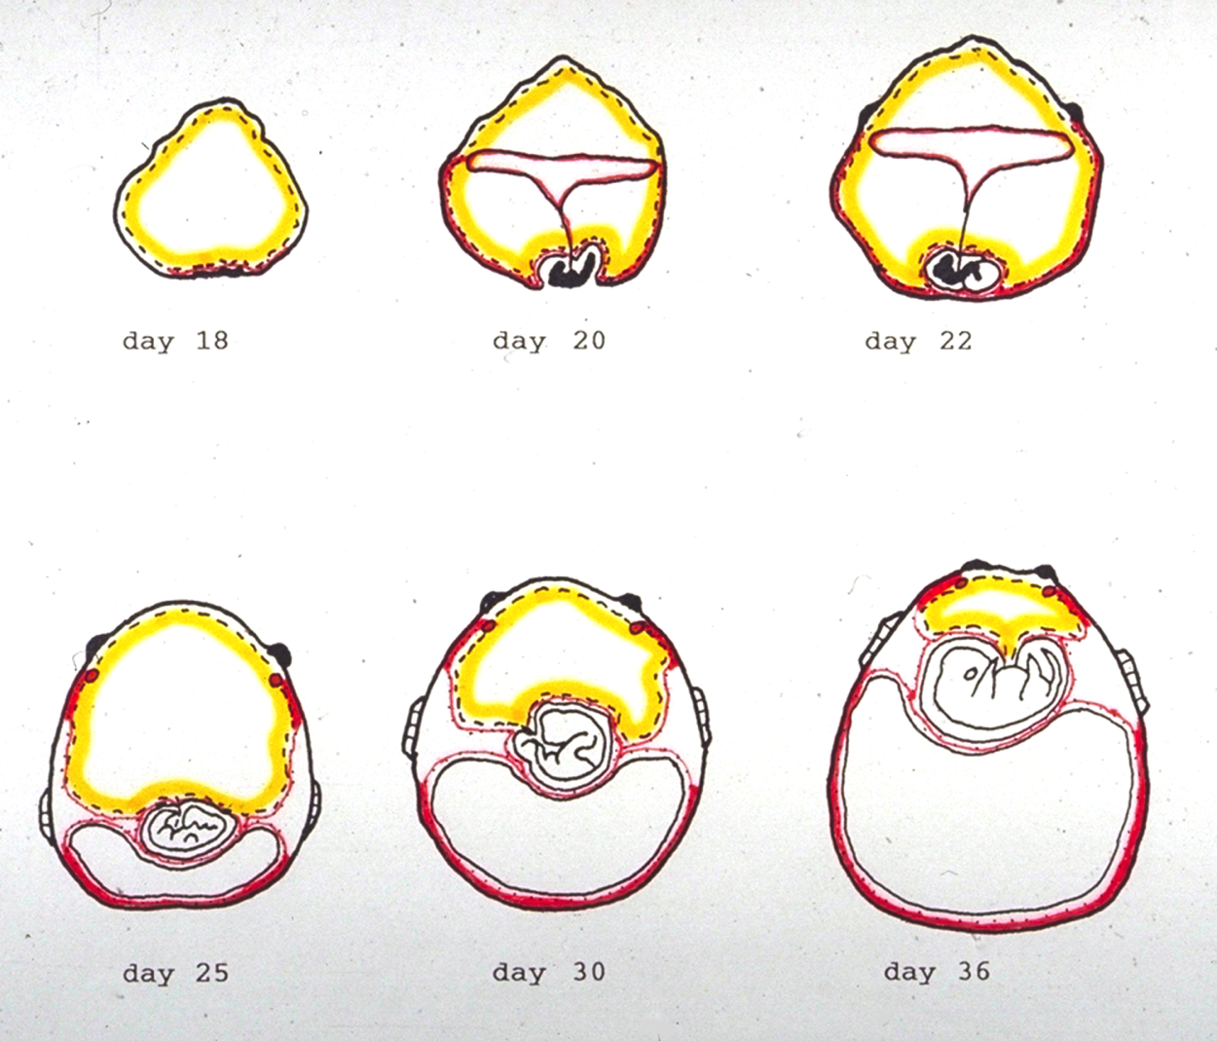
Diagram of development of vascular and avascular yolk sac and later of the allantois.

Slide 25
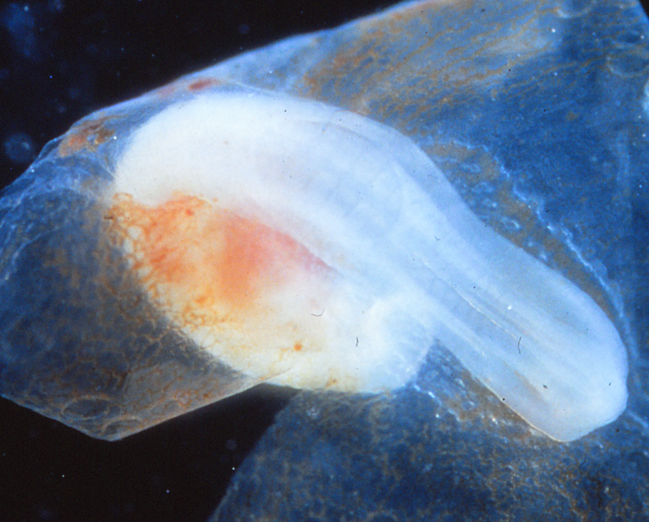
Dorsal view of the day 20 embryo. The pale ellipse overlying the embryo is the opening in the amnion that has not yet closed. At this stage there is still a capsule which has been removed.

Slide 26
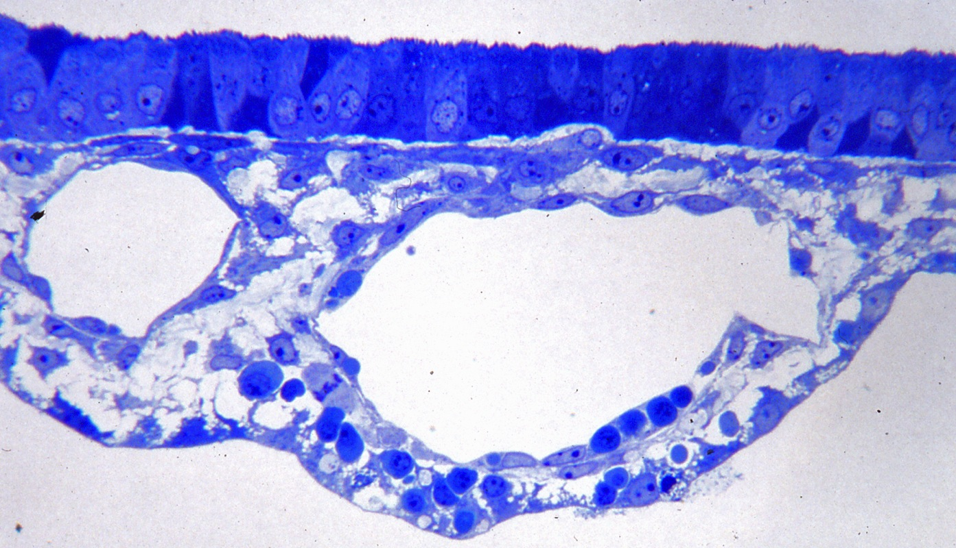
Vascular yolk sac with forming blood cells between the endoderm and endothelium of the larger vessel.

Slide 27
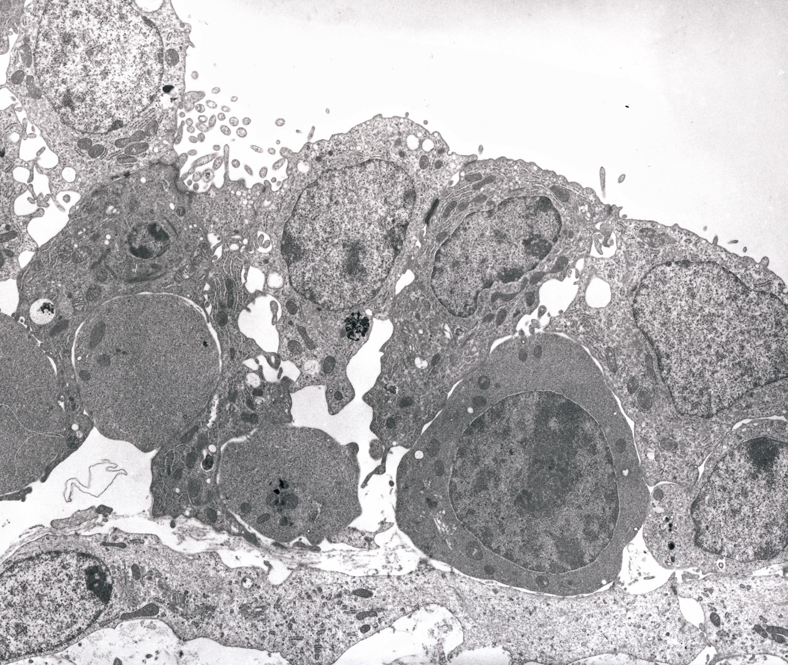
Developing erythrocytes in the yolk sac.

Slide 28
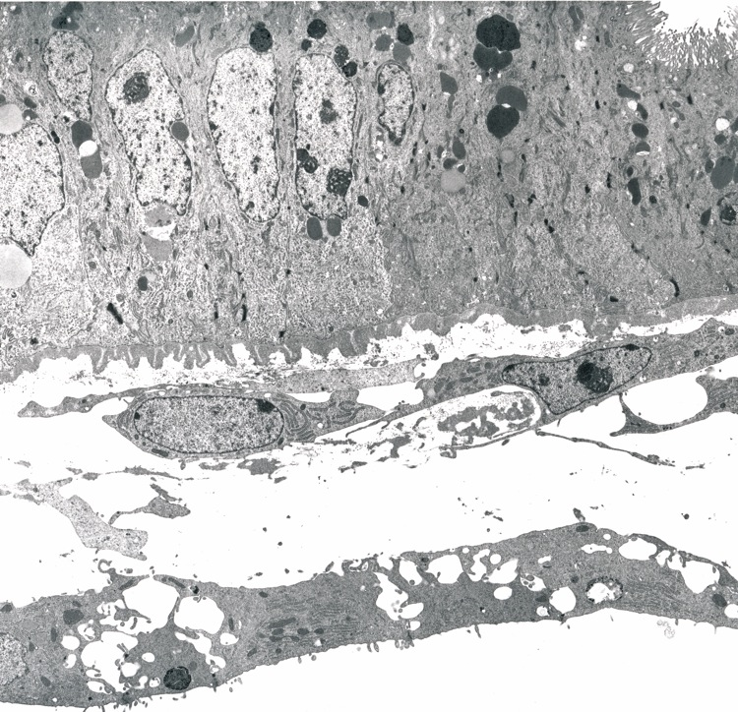
Junction between bilaminar yolk sac on the left, trilaminar yolk sac on the right.

Slide 29
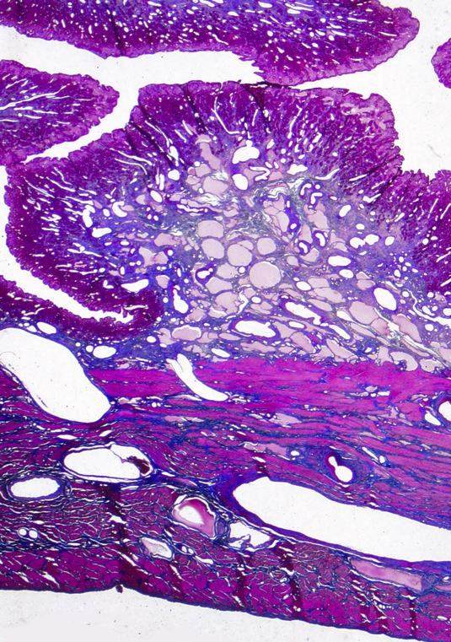
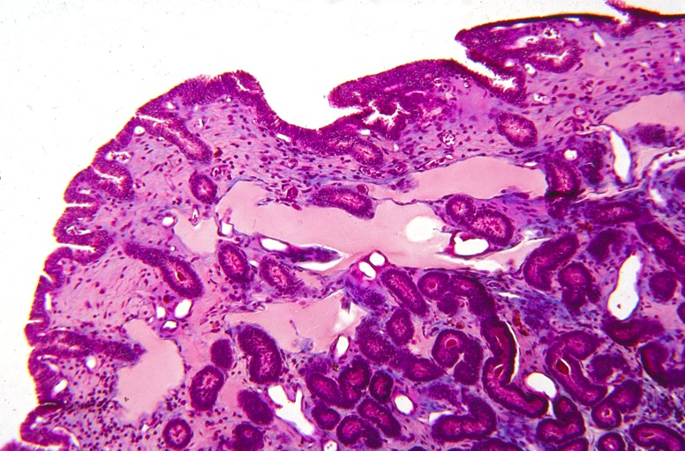
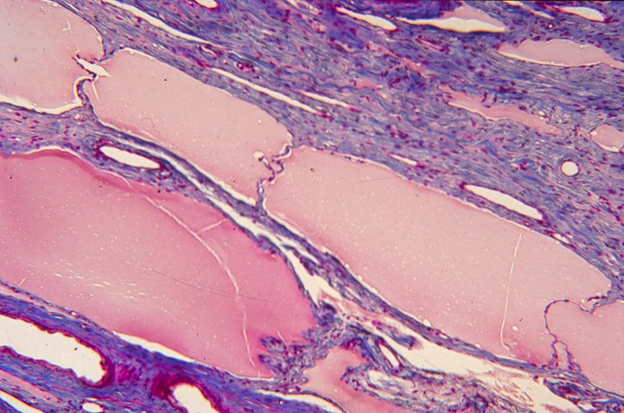
Superficial lymphatics .
Perfusion of maternal vascular system leaves the abundant lymphatic vessels filled with plasma and the blood vessels empty.
Valves in the major lymphatics underlying the endometrium.

Slide 30
STAGE OF IMPLANTATION AND TROPHOBLAST GIRDLE FORMATION
Day 22 – 35
Slides 30 - 69
When the capsule is lost, the blastocyst can be considered implanted since it is in a fixed position and in an intimate relationship with the endometrial surface.
Although the allantois is developing, the yolk sac is a prominent feature of the conceptus at this time.

Slide 31
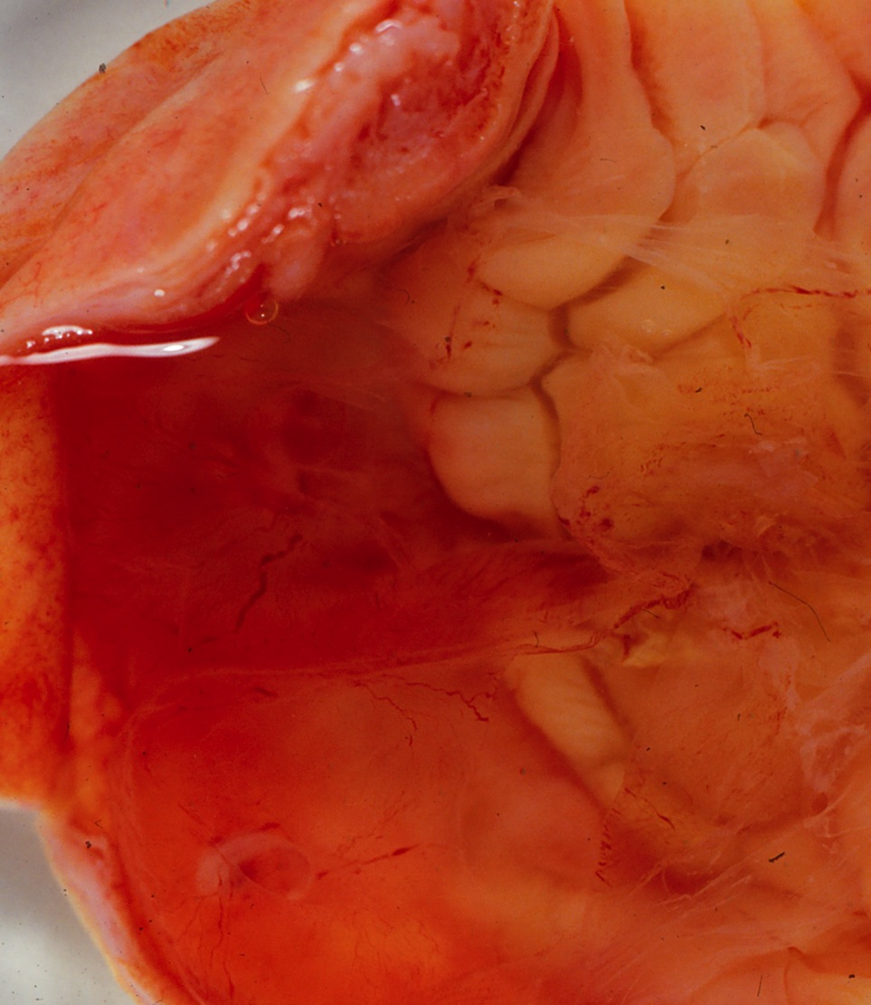
This day 22 implantation chamber contains two embryos.
The one on the lower left can be more readily seen.

Slide 32
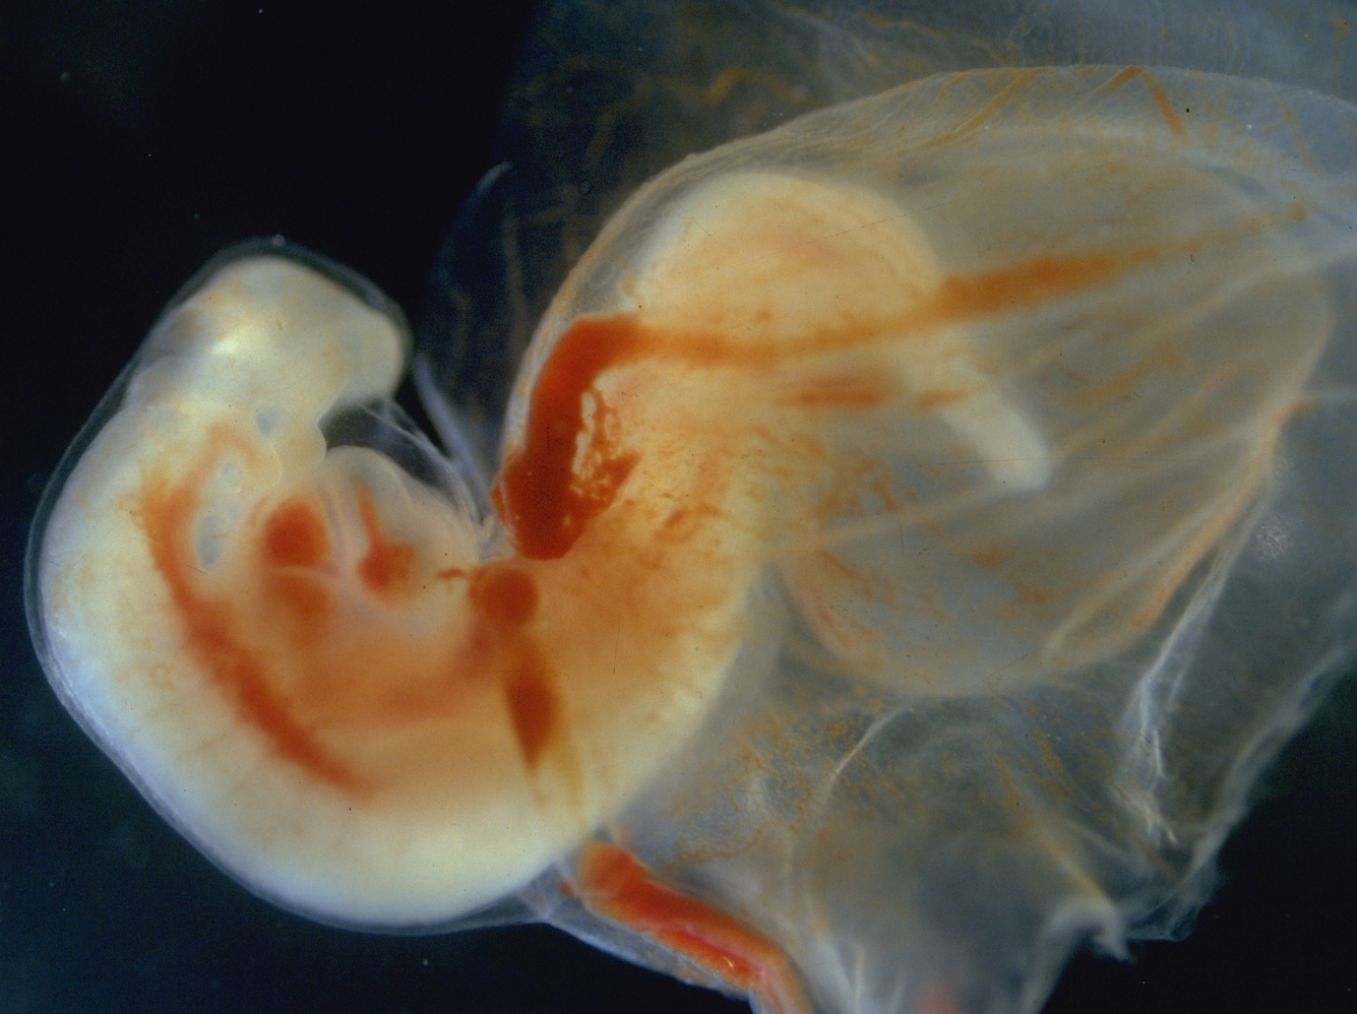
One of the day 22 embryos showing the allantoic sac on the right. The allantois arises at the time circulation is beginning and is consequently vascular from the start.

Slide 33
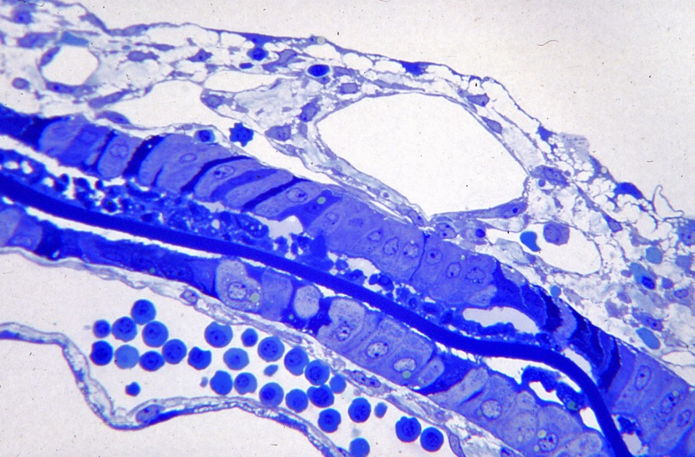
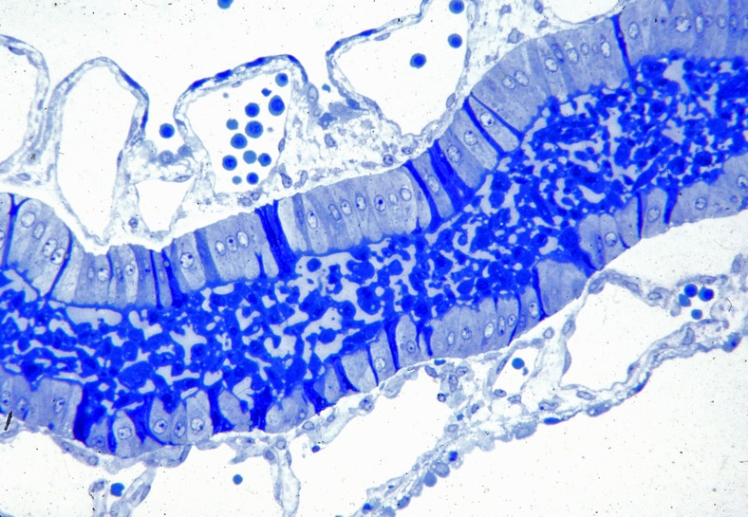
Area between the yolk sac of the two embryos showing trapped capsule. This is the stage at which the capsule ruptures, exposing fetal membranes to the uterine environment. Since the conceptus is already fixed in position, this stage can be considered the stage of implantation.
Sloughed trophoblast cells appear between trophoblast layers of the adjacent vascular yolk sacs in an area where the capsule has been lost

Slide 34
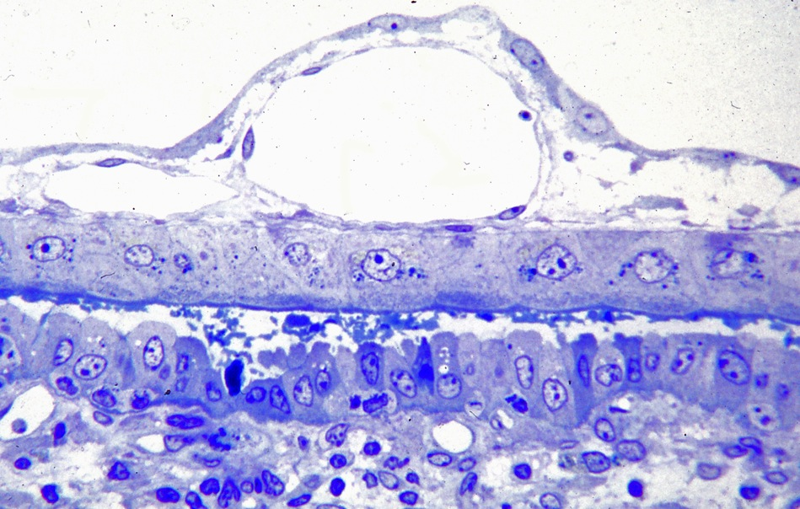
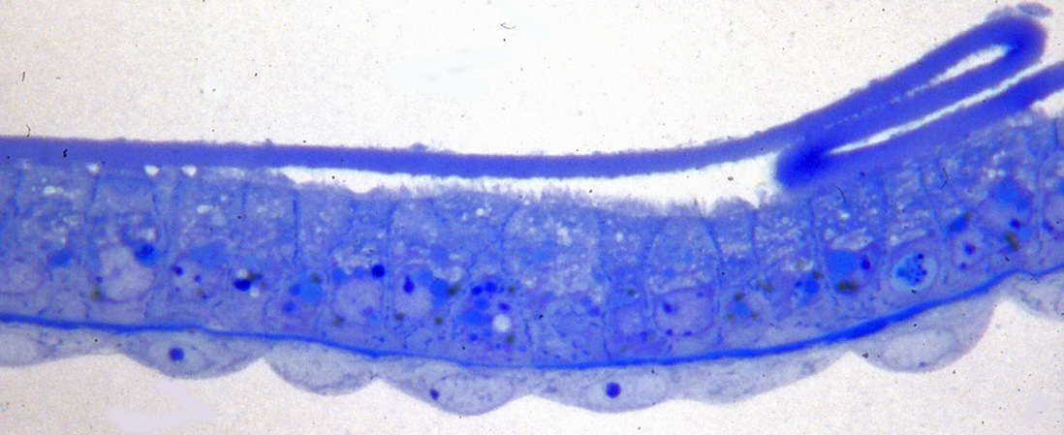
Choriovitelline region where the vascularized trophoblast abuts the endometrium (below).
Bilaminar yolk sac with a folded remnant of the capsule.

Slide 35
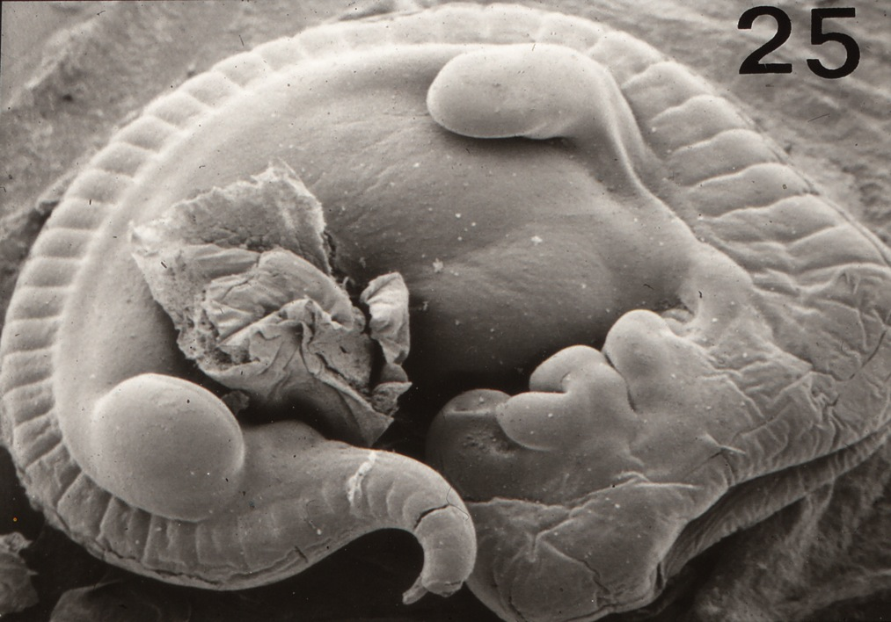
Scanned embryo shows the development of mandibular and maxillary arches.

Slide 36
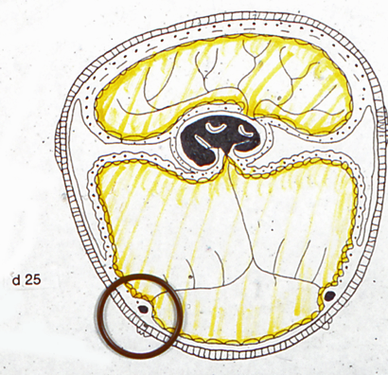
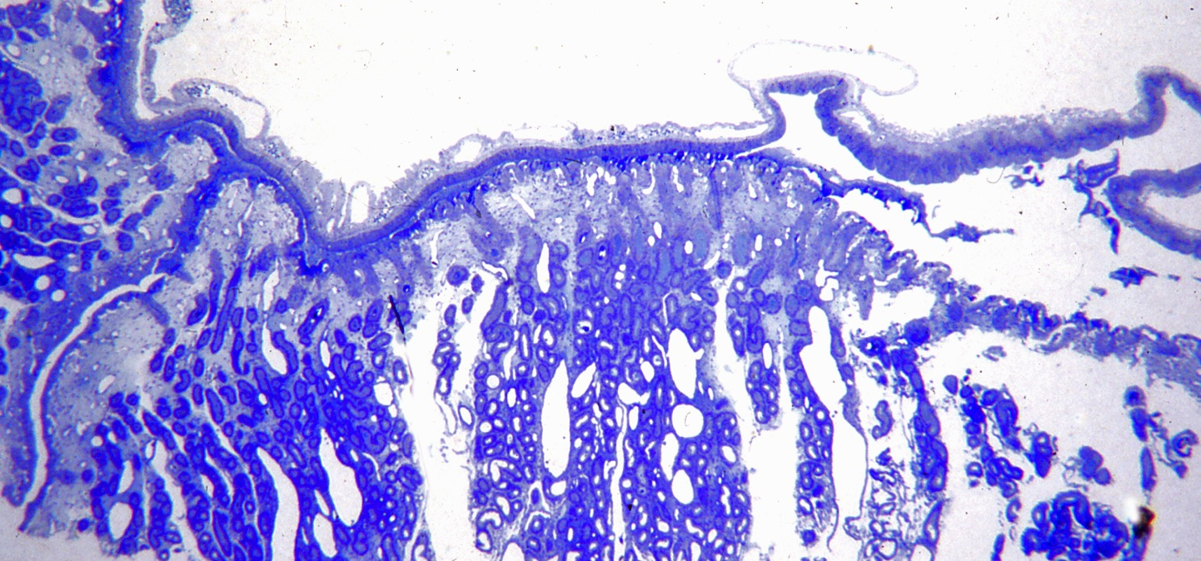
By day 25 the major regions of the extraembryonic membranes have appeared. The upper left of the day 25 diagram is a ridge of trophoblast cells that will be the trophoblast girdle. The circle is the sinus terminalis region.
Sinus terminalis is a large vessel on the right between bilaminar and vascular yolk sacs.

Slide 37
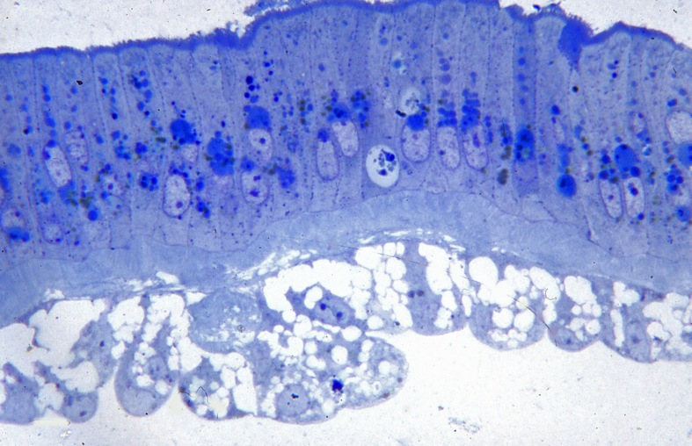
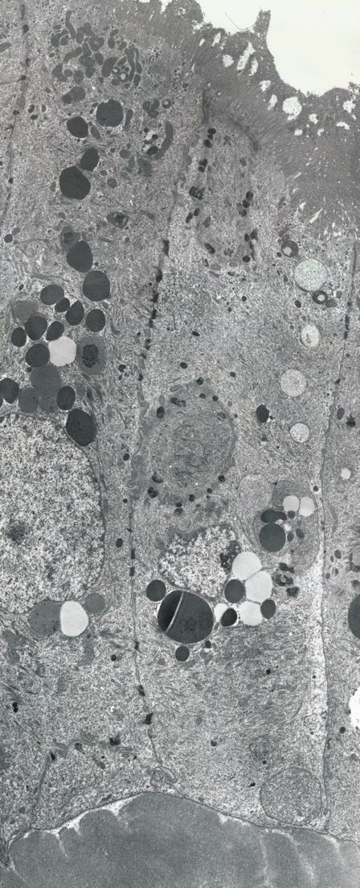
Bilaminar yolk sac showing columnar trophoblast overlying a thick basal lamina and vacuolated endodermal cells.
Columnar trophoblast cells

Slide 38
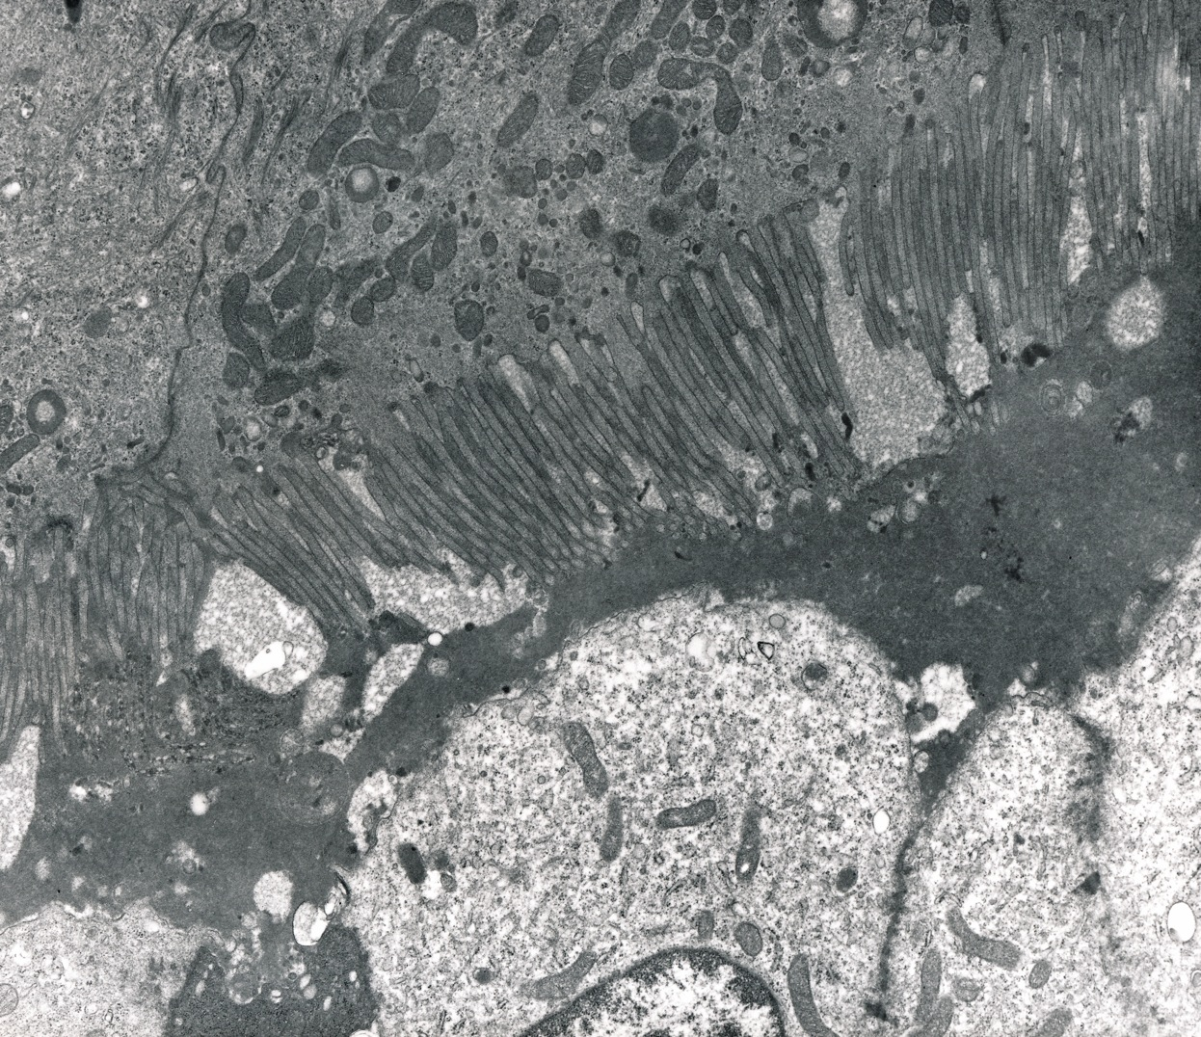
Trophoblast overlies material between these cells and uterine epithelial cells below.

Slide 39
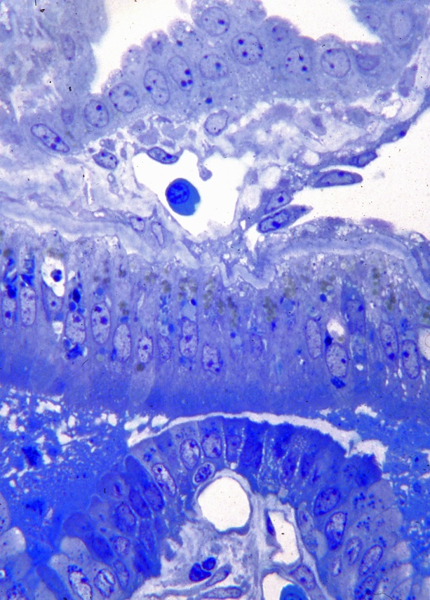
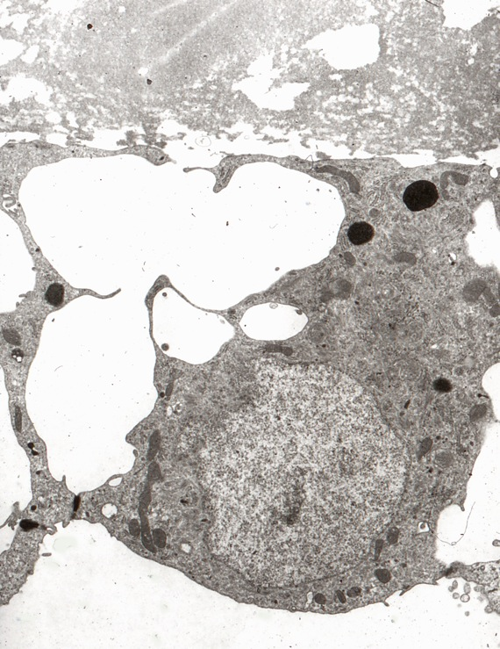
An endodermal cell from the bilaminar region.
Junction of free yolk sac upper right and trilaminar yolk sac.
The mesothelial cells line the exocelom to the right.
Columnar trophoblast overlies the uterine epithelial cells below.

Slide 40
Vascular yolk sac. The blood vessels are not adjacent to the underlying trophoblast.

Slide 41
The circle denotes the area of allantochorionic placenta.
The allantochorion abuts the endometrium.
The maternal vessels are empty of erythrocytes because of perfusion fixation.

Slide 42
Note the close apposition of fetal capillaries to trophoblast, in contrast to the choriovitelline placenta. The allantoic endoderm (at top) is thin. The successful maternal vascular perfusion has eliminated the blood from the superficial endometrial vessels.

Slide 43
Allantochorion.
Although the trophoblast abuts uterine luminal epithelium below, there is no interdigitation.

Slide 44
Endometrial gland epithelium. Note the accumulation of secretory material in the gland lumen,
upper right.

Slide 45
Elongated trophoblast cells in region where the trophoblast girdle will form, underlain by a basal lamina and exocelomic mesothelium.

Slide 46
Conceptus in situ day 28.

Slide 47
Embryo, day 28.

Slide 48
Scan showing development of visceral arches with the maxillary process reaching the nasal placode. The limb buds are still paddle-like.

Slide 49
Diagram showing the allantois above the developing girdle and narrow exocelom and yolk sac including the annulus at the sinus terminalis

Slide 50
The free yolk sac on the right joins the choriovitelline placenta on the left.
Choriovitelline placenta. The yolk sac vessels are central between endoderm above and trophoblast below.

Slide 51
The endoderm of the choriovitelline placenta is in the upper portion of the figure.

Slide 52
A region of chorion with tall columnar trophoblast cells overlying exocelomic mesothelium (future girdle).
Chorion with low trophoblast overlying endometrium

Slide 53
Allantochorion showing proximity of fetal capillaries to trophoblast.
Allantochorion with allantoic endoderm above, trophoblast below

Slide 54
Embryo showing beginning of pigmentation of the eye and limb bud expansion, day 30

Slide 55
Sinus terminalis region showing a ridge or annulus under the terminalis. Bilaminar yolk sac on left, trilaminar on right.

Slide 56
Diagram: The trophoblast annulus is in lower left; the sinus terminalis and vascular yolk sac on the right. The endoderm is yellow, trophoblast pale blue.
Area where the annulus indents the endometrium.

Slide 57
The columnar trophoblast cells of the annulus overlie extensive basal lamina material, fibroblasts, and matrix.

Slide 58
Elongated trophoblast cells and thickened basal lamina at annulus

Slide 59
Trilaminar yolk sac.
Note substantial endoderm above.
Bilaminar yolk sac overlying endometrial folds.

Slide 60
Chorion where trophoblast cells are pseudostratified as the girdle begins to develop ,day 32
Developing girdle. Note the mitotic cells
Trophoblast girdle. Note crowding of trophoblast cells in this region.

Slide 61
Elongated trophoblast cells in girdle

Slide 62
Allantochorion showing fetal vessels adjacent to trophoblast
Note the free space within the connective tissue between the thin allantoic endoderm above and the vascular connective tissue below (an exocelom like space).

Slide 63
Allantochorion adjacent to uterine epithelium below.

Slide 64
Endometrial gland. Note ciliated cell in upper right and granules in the apices of gland cells.

Slide 65
Conceptus day 35. Note the fine branched vessels of the yolk sac and the rotation of the forelimb. The irregular pale band at the edge of the allantoic vessels is the girdle.

Slide 66
Relative sizes of the regions from the yolk sac to the girdle.

Slide 67
Diagram of a section of the wall of the conceptus between the allantois on the right and the yolk sac and sinus terminalis on the left. The trophoblast girdle cells build up over the exocelom, with only the small portion near the allantois being vascularized.
This is the side of the girdle toward the yolk sac. The unmodified chorion is in the lower left.
The side of the girdle towards the amnion is underlain by small vessels which come from the major allantoic vessels. Note also the
small openings in the girdle.

Slide 68
Lectin stain DBA shows both secretory product in surface trophoblast cells of the girdle and in gland-like clefts within the girdle.
The free surface of the girdle shows projections from trophoblast cells, many of which are already binucleate.

Slide 69
The annulus is still present adjacent to the sinus terminalis. On the right is bilaminar yolk sac, on the left is vascular yolk sac.
The choriovitelline placenta is still prominent but the connective tissue between endoderm above and trophoblast below is denser.
Extending upward is the free yolk sac. On the right is vascular yolk sac, on the left chorion- trophoblast underlain by mesothelium of the exocelom.

Slide 70
ENDOMETRIAL INVASION BY BINUCLEATE TROPHOBLAST CELLS
Day 36 –
Slides 70 - 103

Slide 71
Conceptus in situ Day 36. The prominent ring in the center is the annulus adjacent to the sinus terminalis. The pale outer ring that shows gaps is the girdle at a stage where some regions have begun to invade the uterus and were removed during opening of the site.

Slide 72
Removed conceptus. Note the extensive vascularity with fine vessels of the yolk sac, compared to larger but fewer vessels of the allantois.

Slide 73
Day 36 embryo

Slide 74
Region of attachment of the girdle to an endometrial fold.
At the top of the girdle are a few basal trophoblast cells. Binucleate cells occupy much of the girdle and are invading the endometrial fold.
Higher magnification of the attachment and invasion of the central endometrial fold.

Slide 75
An area where girdle cells are invading three endometrial folds
A region where the girdle is close to uterine epithelial cells but neither apposed nor invading. Note projections from binucleate girdle cells.

Slide 76
Another region where the girdle is close to uterine epithelial cells but neither apposed nor invading. Note the blunt ectoplasmic projections from binucleate girdle cells above.

Slide 77
In the gland-like pits within the girdle, the binucleate cells have microvilli and ectoplasmic projections, as they do at the surface facing the uterus

Slide 78
Scanning micrograph showing ectoplasmic projections from some of the girdle cells toward the underlying uterine epithelial cells

Slide 79
Diagram of relationships in early stages of girdle cell invasion of the endometrium.
On the left processes from the binucleate trophoblast cells are penetrating the apices of the uterine epithelial cells.
In the middle they have penetrated to the basal lamina of the epithelium.
On the extreme right the trophoblast cells are intruding under the gland epithelium.

Slide 80
An ectoplasmic process from a binucleate cell is intruding into an epithelial cell in the upper middle.

Slide 81
Note how ectoplasmic processes from the binucleate cells distort luminal epithelial cells below.

Slide 82
Binucleate cells on the left have penetrated through the luminal epithelium to the basal lamina of the epithelium. On the right the luminal epithelium is still intact.

Slide 83
Binucleate trophoblast cells have pushed into the gland in the center, separating the glandular epithelial cells from their basal lamina.
A binucleate cell on the left undercuts gland cells on the right.

Slide 84
A binucleate cell beneath gland cells, one of which is ciliated. Note the single lymphocyte in between.

Slide 85
A binucleate cell that is differentiating into a cup cell is lying on a residual basal lamina.

Slide 86
Binucleate cells from the girdle above rest along the residual basal lamina of the uterine luminal epithelium. A number of vacuoles within the endometrium are beneath the binucleate cells. Note the basal layer of pale cells overlying the binucleate girdle cells.
While most of the girdle cells are situated along the basal lamina of the uterine epithelium, some are within the glands below.

Slide 87
Processes from binucleate trophoblast cells rest on the basal lamina above an endometrial capillary.

Slide 88
Accumulation or processes from binucleate cells.
There is some vacuolation in the endometrium.

Slide 89
Although the glands have been infiltrated by trophoblast, the only trophoblast within the endometrial stroma is in the extreme lower left.
A higher mag of the region to the left where binucleate trophoblast cells are entering the endometrial stroma.

Slide 90
Columns of pale binucleate cells extend into the endometrial stroma between glands.

Slide 91
Higher mag of a region where large binucleate trophoblast cells are extending into the endometrial stroma

Slide 92
A process from the large binucleate trophoblast cell extending into the endometrium.

Slide 93
Binucleate cells that are differentiating into endometrial cup cells, with extensive regions of granular ER . There are still a few ectoplasmic processes.

Slide 94
Separation of the trophoblast of the allantois from the residual girdle material.

Slide 95
The separation is not neat, and can leave a jagged surface on the residual binucleate girdle cells.

Slide 96
Allantochorion.
Note the small allantochorionic capillaries adjacent to and indenting the trophoblast, and the wealth of endometrial capillaries beneath the uterine epithelium.

Slide 97
Allantochorionic trophoblast overlying uterine luminal epithelium

Slide 98
Note the space between the connective tissue associated with allantoic endoderm above
and that near the vessels associated with the trophoblast below. The function of this celom- like space is unknown.

Slide 99
Region of the annulus adjacent to the sinus terminalis of the yolk sac.
Trilaminar on left, bilaminar on right.
Trilaminar yolk sac. The trophoblast above, endoderm below.

Slide 100
Trophoblast of the trilaminar yolk sac.

Slide 101
Endoderm of the trilaminar yolk sac. Note strands of rER.

Slide 102
Bilaminar yolk sac showing dense basement membrane under the trophoblast, and spaces within the endodermal layer below.
Annulus near the sinus terminalis on the left, and the indent that it has left in the endometrium on the right.

Slide 103
Gland cells showing numerous granules.

Slide 104
COMPLETION OF GIRDLE CELL INVASION OF THE ENDOMETRIUM.
During days 37 and 38, different regions of the girdle invade folds of endometrium. The strands of girdle cells migrate into the endometrial stroma and between gland cells and their basal lamina.
In addition, superficial lymphatic vessels but not blood vessels are invaded by binucleate trophoblast cells,.

Slide 105
Day 37 implantation site. Some of the girdle can be seen as a pale crescent to the right of the embryo. The allantoic vessels are conspicuous.

Slide 106
On the left, the trophoblast cells from the girdle have invaded the endometrium. On the right, the edge of the girdle has not invaded but binucleate trophoblast cells from the girdle underlie the uterine luminal epithelium.
Enlargement of region where binucleate cells have extended laterally between the pale uterine luminal epithelial cells and their basal lamina.

Slide 107
Trophoblast cells showing both a metaphase plate and in an adjacent cell an ectoplasmic projection of the sort that is involved in invasion of the endometrium.
A region where trophoblast cells have invaded the endometrium as far as the uterine luminal basal lamina; remnants of the girdle are separating from invading binucleate trophoblast cells.

Slide 108
Note the penetration of the basal lamina by binucleate trophoblast cells in the lower center.
Processes from binucleate trophoblast cells have invaded and distorted the uterine epithelium in the upper left.

Slide 109
On the left girdle cells have separated from trophoblast cells that have invaded the endometrium and that will be involved in cup formation.
Binucleate trophoblast cells invade lymphatic vessels but not blood vessels

Slide 110
TEM of binucleate trophoblast in a lymphatic vessel

Slide 111
Massive invasion of the endometrium by binucleate trophoblast cells in a region with many lymphocytes. Note the slightly thickened walls of blood vessels in the lower left.

Slide 112
Section through the trophoblast annulus adjacent to the sinus terminalis of the yolk sac (left).
The trophoblast is multilayered, the basal lamina is thick and the underlying endodermal cells are irregular and vacuolated.

Slide 113
Binucleate trophoblast cells that have not attached to the endometrium are undergoing disintegration except for those adjacent to the exocelom. Day 38
Binucleate trophoblast cells have entered the stroma of the endometrium.

Slide 114
Differentiation of binucleate cells into cup cells is beginning, as depicted from their increased size and rER.

Slide 115
Binucleate are seen in the glands and in stroma between glands
Binucleate trophoblast cells are in contact and elongated during migration into endometrial stroma.

Slide 116
A strand of binucleate trophoblast cells underlies gland epithelium and overlies endometrial stroma.

Slide 117
Showing the elongated structure of the binucleate trophoblast cells during migration into endometrial stroma.

Slide 118
Allantochorion showing large allantoic vessels and smaller endometrial capillaries indenting uterine luminal epithelium. Fixation by perfusion of the uterine arteries has removed most of the maternal erythrocytes.

Slide 119
EARLY ENDOMETRIAL CUP
Day 42
Following the initial invasion of the endometrium by binucleate trophoblast cells, the trophoblast cells stop migrating and differentiate into large cup cells.
Although the binucleate cells penetrate and inhabit the superficial lymphatics, they do not enter blood vessels or cause any increase in the already present vasculature.
The yolk sac is an increasingly smaller portion of the placental structure, but its constituents remain well vascularized and viable.

Slide 120
Day 42 Trophoblast cells form a substantial endometrial cup overlying the deeper regions of the endometrium.
The trophoblast cells in the cup are hypertrophying and are no longer invading.

Slide 121
Most of the binucleate trophoblast cells in the endometrium are enlarged; some of the cells left from the invasion near the lumen are disintegrating.

Slide 122
Hypertrophied trophoblast cells in endometrium with numerous lymphocytes.
Trophoblast cells have entered a lymphatic vessel below a forming cup.

Slide 123
Differentiating cup cells

Slide 124
Invasion of a lymphatic vessel. Note the healthy adjacent endometrial glands and small uninvaded capillaries in the endometrium.
Trophoblast cells in a lymphatic vessel. Note the thin endothelial cells lining the lymphatic.

Slide 125
A trophoblast cell on the right is adjacent to an unmodified maternal vessel.

Slide 126
Note the large Golgi zone to the right of the cup cell nucleus

Slide 127
Trophoblast cells that are differentiating into cup cells.

Slide 128
Allantochorion is closely associated with endometrial luminal epithelium. There tends to be an irregular space between connective tissue underlying the endodermal lining of the allantois above and the region rich in allantoic vessels adjacent to trophoblast.

Slide 129
Allantochorion overlying a cup.

Slide 130
The annulus associated with sinus terminalis is on the right. A short stretch of choriovitelline placenta is on the left. Free yolk sac is above left.

Slide 131
Choriovitelline placenta. Note that vitelline vessels are close to overlying endoderm, and connective tissue overlying trophoblast is denser. Note also that there is extracellular material between the trophoblast and the uterine luminal epithelium.

Slide 132
ENDOMETRIAL CUP
Day 45 – 51
Slides 132 - 156

Slide 133
Day 45 fetus

Slide 134
Cup cells between endometrial glands. The more superficial trophoblast cells have not hypertrophied.
The cup cells extend through 2/3 of the endometrium

Slide 135
The distribution of TGFa demonstrates that there is modification of upper portions of glands within the cup.

Slide 136
Region where luminal epithelium overlies a cup. There is no hypertrophy of the endothelium of the blood vessels in the cup.
Cup cells between a gland on the left and endometrial capillary on the right. There is no increase in number of vessels when trophoblast binucleate cells enlarge to form a cup. Consequently cup areas appear pale.

Slide 137
Healthy cup cells below, gland cells above. Unlike during invasion, the cup cells are outside the basal lamina of the gland cells.

Slide 138
Cup cells that have entered a lymphatic vessel have hypertrophied.
Cup cells in a lymphatic. Endometrial vessels are immunostained for Factor VIII antigen.
Distribution of intermediate filaments in cup cells shown by antibody to cytokeratin.

Slide 139
Immunostain for vimentin shows distribution of endometrial stromal cells between cup cells and near glands.
Higher mag showing cytokeratin bundles within trophoblast cells, especially around Golgi regions.

Slide 140
Endometrial gland cells with numerous apical granules.

Slide 141
Many cup cells have vesicular rER in addition to a few lipid droplets and large Golgi zones.

Slide 142
Corresponding surface of the uterus underlying allantochorion
SEM of surface of allantochorion.

Slide 143
Fold of allantochorion is associated with uterine luminal epithelium. The squamous endoderm above lines the allantoic cavity. An irregular space is within the allantoic stroma.
Trophoblast cells are not closely associated with luminal epithelium, are elongate, and contain numerous granules. This may be the beginning of an arcade area or alveolus.

Slide 144
Trophoblast of the allantochorion overlying luminal epithelium.

Slide 145
Portion of fetal membranes removed from the implantation site and folded such that chorion faces annulus.

Slide 146
Free yolk sac. The endodermal cells are more robust than mesothelial cells.
Trilaminar yolk sac (choriovitelline placenta). Note that blood vessels are closely associated with endoderm above, not trophoblast below.

Slide 147
Endometrial cup formed by hypertrophied trophoblast cells within the endometrium. Note the dilation of the basal endometrial glands associated with the cup, compared to glands in non-cup area in the lower left.

Slide 148
On the left, the allantochorion overlies secretions and debris from the cup area. At the bottom is a cluster of lymphocytes. Large cup cells surrounded the gland in the center.
Left margin of the previous micrograph.

Slide 149
Near the center, a gland opens onto the surface of the cup beneath allantochorionic trophoblast. The gland secretions are not homogeneous.
Cup cells with a few lipid droplets, healthy gland epithelium, and an endometrial vessel with thickened basal lamina, as well as fibroblasts.

Slide 150
Portions of two cup cells. Note the extensive Golgi zones.

Slide 151
Interdigitation between two cup cells

Slide 152
Endometrial capillary with thickened basal lamina between cup cells.

Slide 153
Gland cells on the right appear normal within the cup.

Slide 154
PAS staining of gland cells on the right. Note the stained Golgi zone in the binucleate cup cell in the left center.
Distribution of the lectin SBA shows glycosylated compounds in the Golgi and in gland apices in the upper right.

Slide 155
Alcian blue staining of gland cell granules and secretion.
Antibody to eCG is in the Golgi zones of cup cells.

Slide 156
Fluorescent staining of antibody to eCG denotes Golgi zones of cup cells
TEM of cup cells; the inset on the right shows eCG-linked gold particles in granules

Slide 157
1988 Enders, A.C., K.C. Lantz, I.K.M. Liu and S. Schlafke. Loss of polar trophoblast during differentiation of the blastocyst of the horse. Journal of Reproduction and Fertility 83:447-460.
1991 Enders, A.C. and I.K.M. Liu. Trophoblast-uterine interactions during equine chorionic girdle cell maturation, migration and transformation. American Journal of Anatomy 192:366-381.
1991 Enders, A.C. and I.K.M. Liu. Lodgement of the equine blastocyst in the uterus from fixation through endometrial cup formation. Journal of Reproduction and Fertility, Suppl. 44:427-438.
1993 Enders, A.C., S. Schlafke, K.C. Lantz and I.K.M. Liu. Endoderm cells of the equine yolk sac from Day 7 until formation of the definitive yolk sac placenta. Equine Veterinary Journal, Suppl. 15:3-9.
1995 Enders, A.C., K.C. Lantz, S. Schlafke and I.K.M. Liu. New cells and old vessels: the remodeling of the endometrial vasculature during establishment of endometrial cups. In: Equine Reproduction VI, Biology of Reproduction Monograph Series 1: 181-190.
1999 Jones, C.J.P., A.C. Enders, R.B.P. Wooding, V. Dantzer, R. Leiser and R.W. Stoddart. Equine placental cup cells show glycan expression distinct from that of both chorionic girdle progenitor cells and early microcotyledonary trophoblast. Placenta 20:347-360.
2000 Enders, A.C. and I.K.M. Liu. A unique exocelom-like space during early pregnancy in the horse. Placenta 21: 575-583.
2000 Enders, A.C., C. J. Jones, K.C. Lantz, S. Schlafke and I.K.M. Liu. Simultaneous exocrine and endocrine secretion: trophoblast and glands of the endometrial cups. In: Equine Reproduction VII. Journal of Reproduction and Fertility, Suppl. 56: 615-625.

